Slide 1
Vexing VBA
Day 5
The Data Boot Camp |
November 15, 2018

Slide 2
Today,
This is you…

Slide 3
Refresher

Slide 4
Fundamentals of Coding
What is meant by the phrase:
“Coding requires thinking procedurally?”

Slide 5
How a Computer Thinks (Procedurally)
Complex Real-World Problem
Every problem in software development begins with a complex and abstract real-world need.

Slide 6
How a Computer Thinks (Procedurally)
Complex Real-World Problem
Step
Step
Step
Step
1
2
3
4
In order for a computer to handle things, this “real-world” problem needs to be broken into a set of procedural steps.

Slide 7
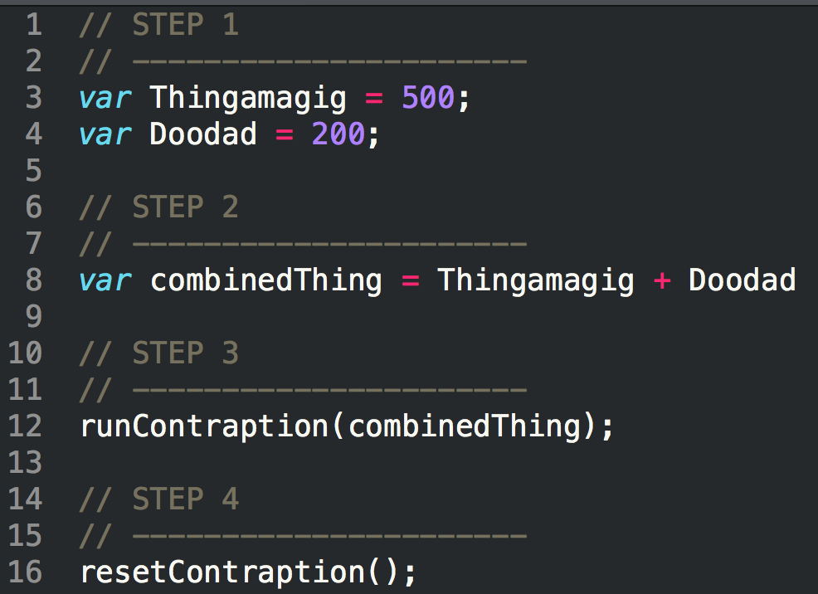
How Code is Written (Procedurally)
Code (JavaScript)
Steps
1
2
3
4

Slide 8
Fundamentals of Coding
What are the four building blocks in programming?

Slide 9
Fundamental Building Blocks
Common structures in nearly all languages:
Variables / Arrays
Conditionals
Iterations
Functions

Slide 10
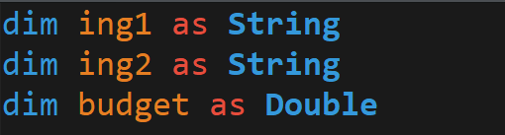
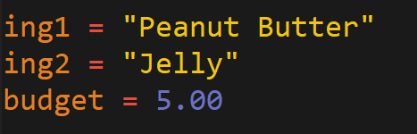
Variables: The Nouns of Code
Variables are effectively the items in a procedure.
They can be physical things (like an ingredient) or abstractions (like a counter).
In VBA, items can be declared as variables by using the dim followed by the type. They can then be assigned a value.
Variable Declaration
Variable Assignment

Slide 11
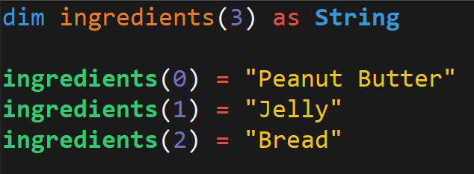
Arrays: A Collection of Items
Arrays are effectively groups of related items. It presents another way to store and reference like pieces of information.
[
Item: 0
Item: 1
Item: 2
[
Peanut Butter
,
Jelly
,
Bread

Slide 12
Conditionals: If This… Then That.
Conditionals present a way to control the flow of logic based on certain conditions being met.
In most languages, we’ll be using if / else code for this purpose.
Step
Step
If Condition a…
2a
1
If Condition b…
2b

Slide 13
Iteration: Round and Round We Go!
Iteration is the concept of using loops to perform a group of tasks repeatedly for a number of times.
In almost all languages, we’ll be using for-loops and while loops.
Step
1
2
Repeat X times…

Slide 14
Functions: For When One Block Can’t Do it All
Functions are, in essence, a sort of “sub-processes”. They allow us to create pre-made, re-usable blocks of code which can be called on demand.
Main Process
1
2
3
4
1
2
3
1
2
3
3
Sub-Processes

Slide 15
Let’s Start Coding

Slide 16
Today’s Agenda
The basic syntax of a VBA For loop
Utilize for-loops in conjunction with conditions to direct logic flow
How to build a nested for-loop
Refine our fundamental coding skills:
Syntax
Pattern
Decomposition
Debugging
???

Slide 17
Group Warm-up - Budget Checker
Part I: Display Budget, Price, Fees and Total. Calculate the total after fees and enter the value in the Total cell:
Total = Price * (1 + Fee)
Part II: Create a budget alert by displaying a Message Box for the user to designate whether the amount including fees is within or over the budget
Part III: If the total is over budget, correct the price such that it fits within the max of the user’s budget (round the price down to use no decimal)
New Price = Budget / (1 + Fee)

Slide 18
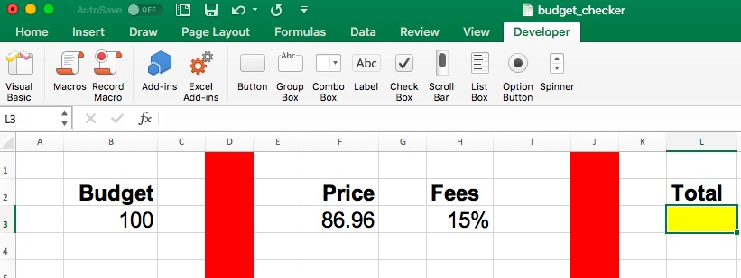
Budget Checker

Slide 19
For Loop

Slide 20
Instructor Demo
basic_for_loop

Slide 21
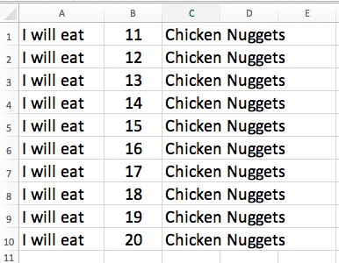
Student Activity – Chicken Nuggets
Create a `For` loop that will produce the following example. The lines signify new cells.
BONUS: If you finish early, talk to your neighbor about why you may want to use a For loop over the "range" function, and offer your help as needed.

Slide 22
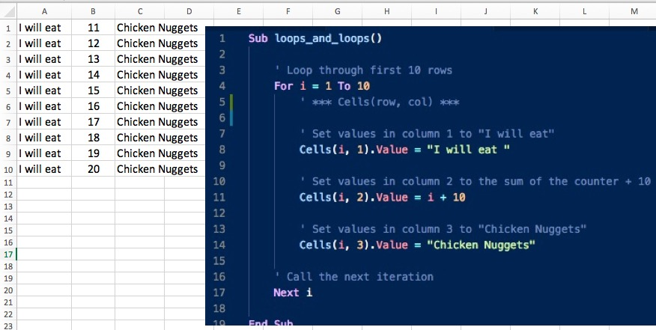
Class Activity – Review Chicken Nuggets

Slide 23
Instructor Demo
conditional_loops / modulus

Slide 24
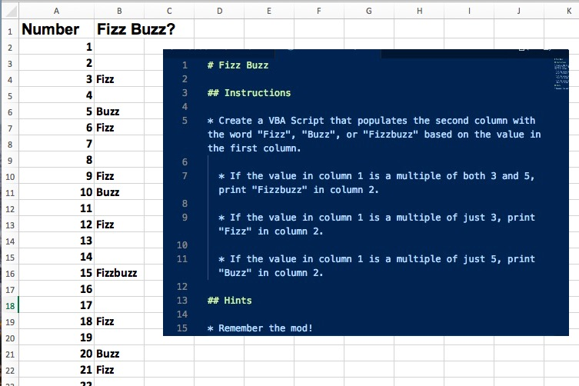
Student Activity – Fizz Buzz

Slide 25
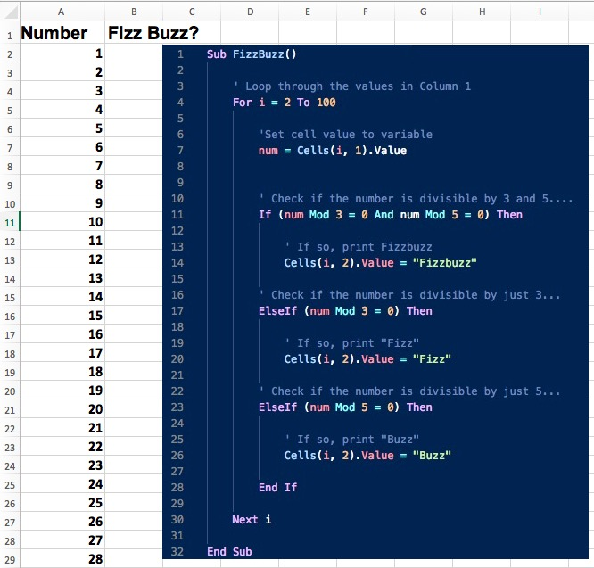
Class Activity – Review Fizz Buzz

Slide 26
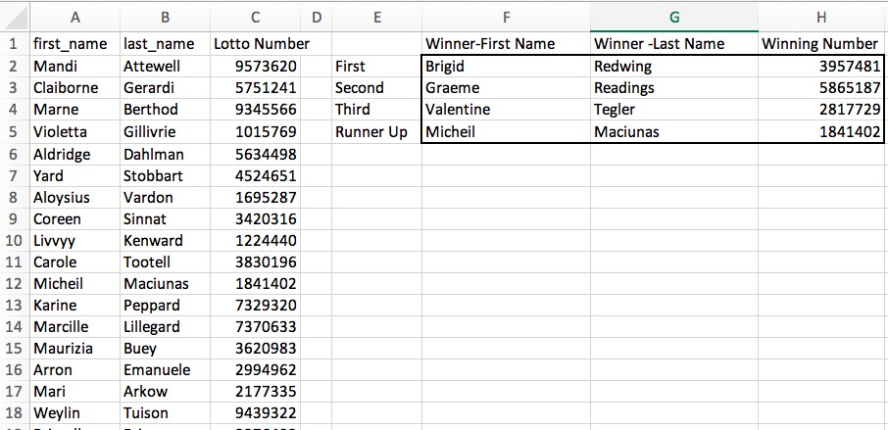
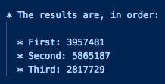
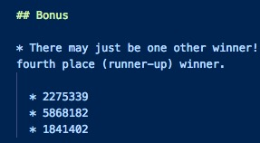
Let’s Go for A Group Activity!
Local Lotto Drawing
* Remember to utilize variables to keep your code clean. * For the bonus, you may need to use `Exit For`

Slide 27
Nested For Loop

Slide 28
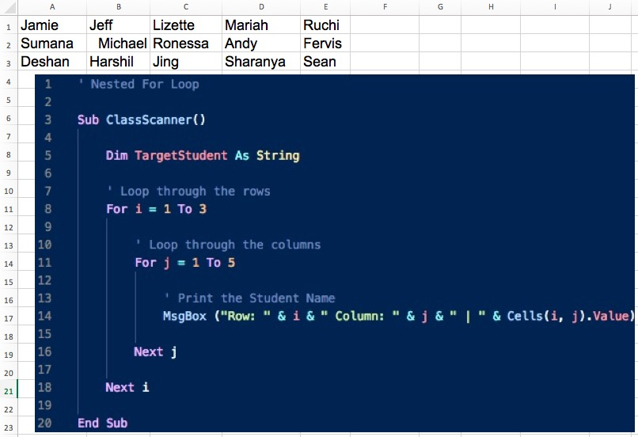
Instructor Demo

Slide 29
Group Activity - Hornets Nest
Create a VBA script to handle the growing Hornet infestation in your spreadsheet.
There are three parts to this problem:
Part I Count the number of Hornets found and display the number to your user in the form of a message box.
Part II Modify the script such that it changes the word Hornets to "Bugs".
Part III Modify the script a third time, this time keeping in mind that you have a limited number of Bugs and Bees.
Use the full set of Bugs and Bees you have available to replace the Hornets with all available Bugs first then Bees.
If you run out of Bugs or Bees provide the user with the message: "Oh no! We still have hornets..."
* **Hints**
You may want to create a backup of your spreadsheet as your macro will write over the contents.

Slide 30
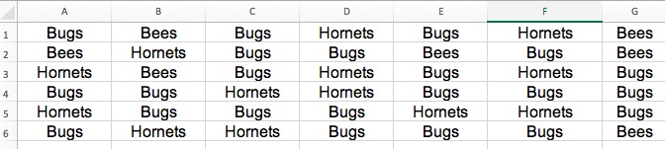
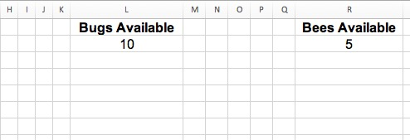
Group Activity - Hornets Nest Cont’d

Slide 31
Questions / Discussion
Notes:
It’s important to keep in mind why you joined this class. Let’s talk about your goals.

